Slide 1







Current and Future Data Trends
Abraham Palma
08/05/2023

Slide 2




OUTLINE
Executive Summary
Introduction
Methodology
Results
Visualization – Charts
Dashboard
Discussion
Findings & Implications
Conclusion
Appendix

Slide 3

EXECUTIVE SUMMARY
Trends in programming languages, databases, and platforms for use in Data Analysis
Methodology
Data Wrangling
Data Analysis
Data Visualization
Demographics
Gender and Education disparity
Geographical disparities

Slide 4

INTRODUCTION
Using Stack Overflow’s 2019 Developer Survey
Current Technology Usage
Future Technology Usage
Global Demographics
Gender
Education Level

Slide 5

METHODOLOGY
Collecting data
Python APIs
Web Scraping
Data Wrangling
Removing Duplicates
Handling missing values
Normalizing Data
Data Analysis
Data Visualization
Dashboard

Slide 6

RESULTS

Slide 7
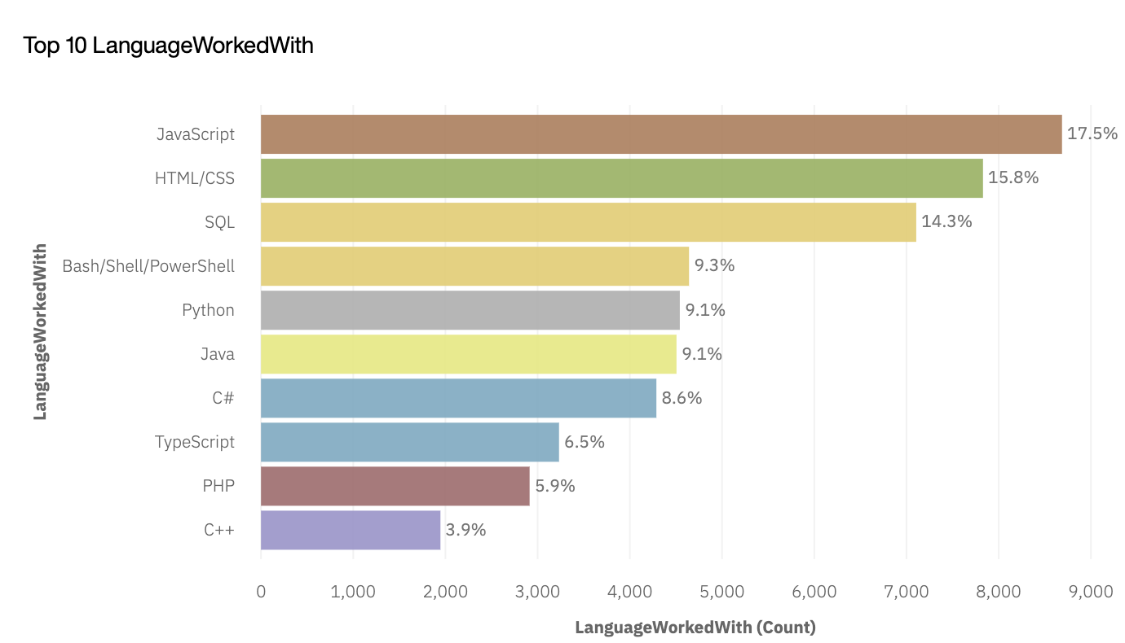
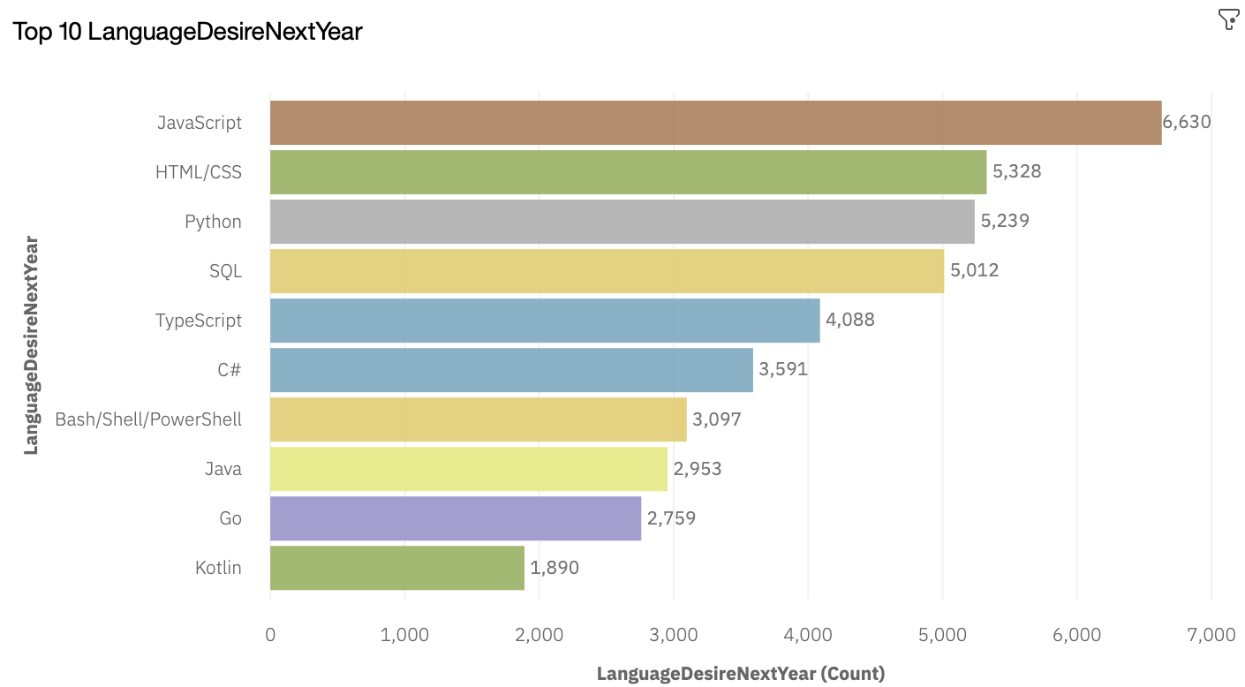
PROGRAMMING LANGUAGE TRENDS
Current Year
Next Year
<Bar chart of top 10 programming languages for the current year goes here.>
< Bar chart of top 10 programming languages for the next year goes here.>

Slide 8
PROGRAMMING LANGUAGE TRENDS - FINDINGS & IMPLICATIONS
Findings
JavaScript and HTML are top 2
Python and Typescript rising
PHP and C++ dropping off top10
Implications
Big Data still relies on SQL
Possible shift from JavaScript to TypeScript

Slide 9
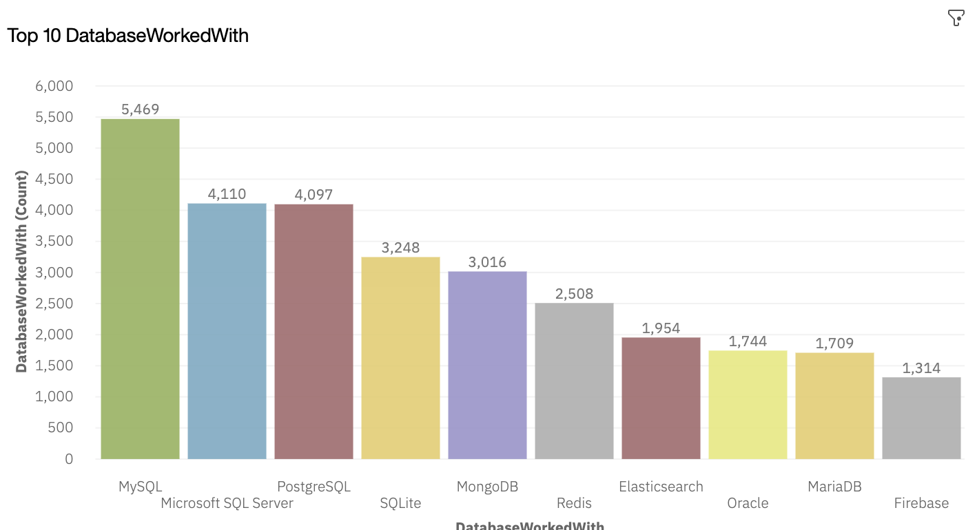
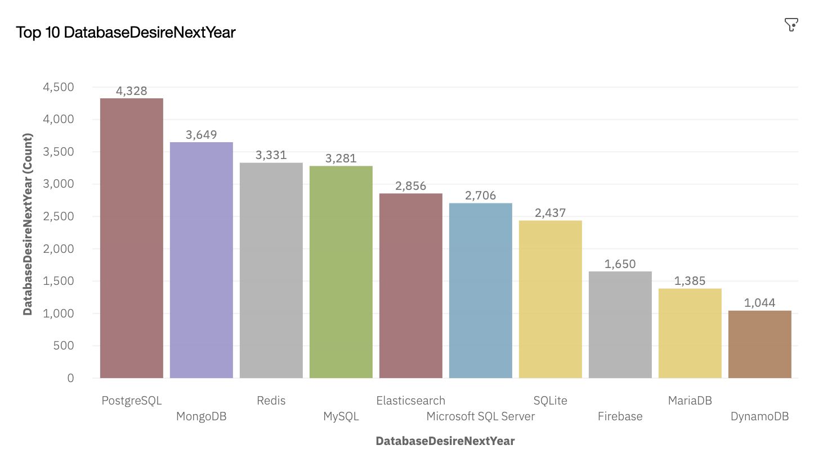
DATABASE TRENDS
Current Year
Next Year
< Bar chart of top 10 databases for the current year goes here >
< Bar chart of top 10 databases for the next year goes here.>

Slide 10
DATABASE TRENDS - FINDINGS & IMPLICATIONS
Findings
SQL based databases still most popular
SQL databases losing ground
Open source databases on top
Implications
MySQL and Microsoft SQL Server losing market share
NoSQL databases gaining ground

Slide 11
DASHBOARD
https://dataplatform.cloud.ibm.com/dashboards/3ef067ca-ae7c-4c92-808c-b03c5bd8e942/view/5463ca1d0cf532ce73c6d4e4079d2b0178377759e0bbd15582867b4906337897f33d40c0c82f4908db455666a0ec145f9d

Slide 12
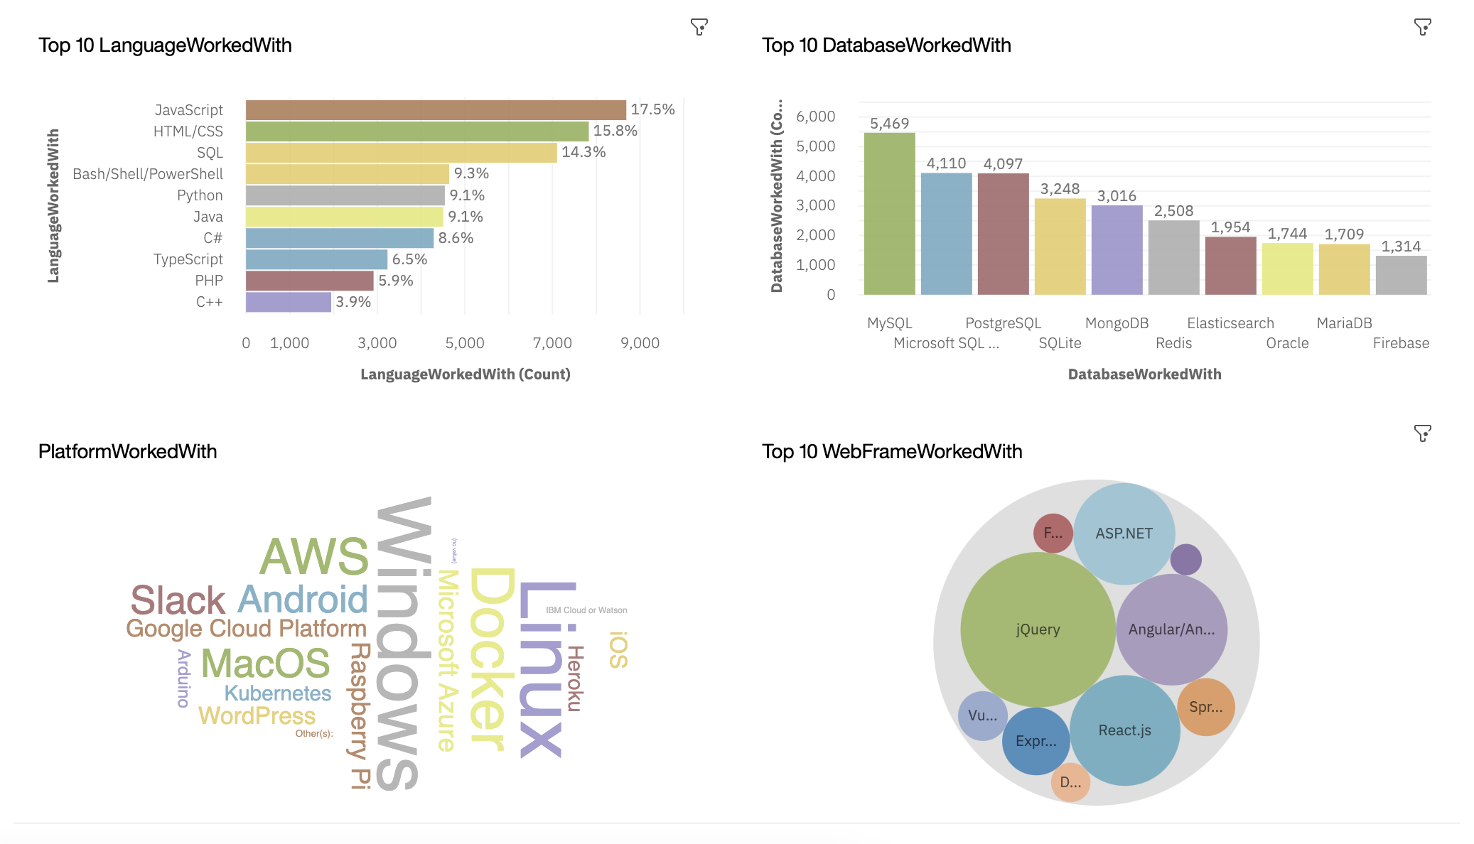
CURRENT USAGE

Slide 13
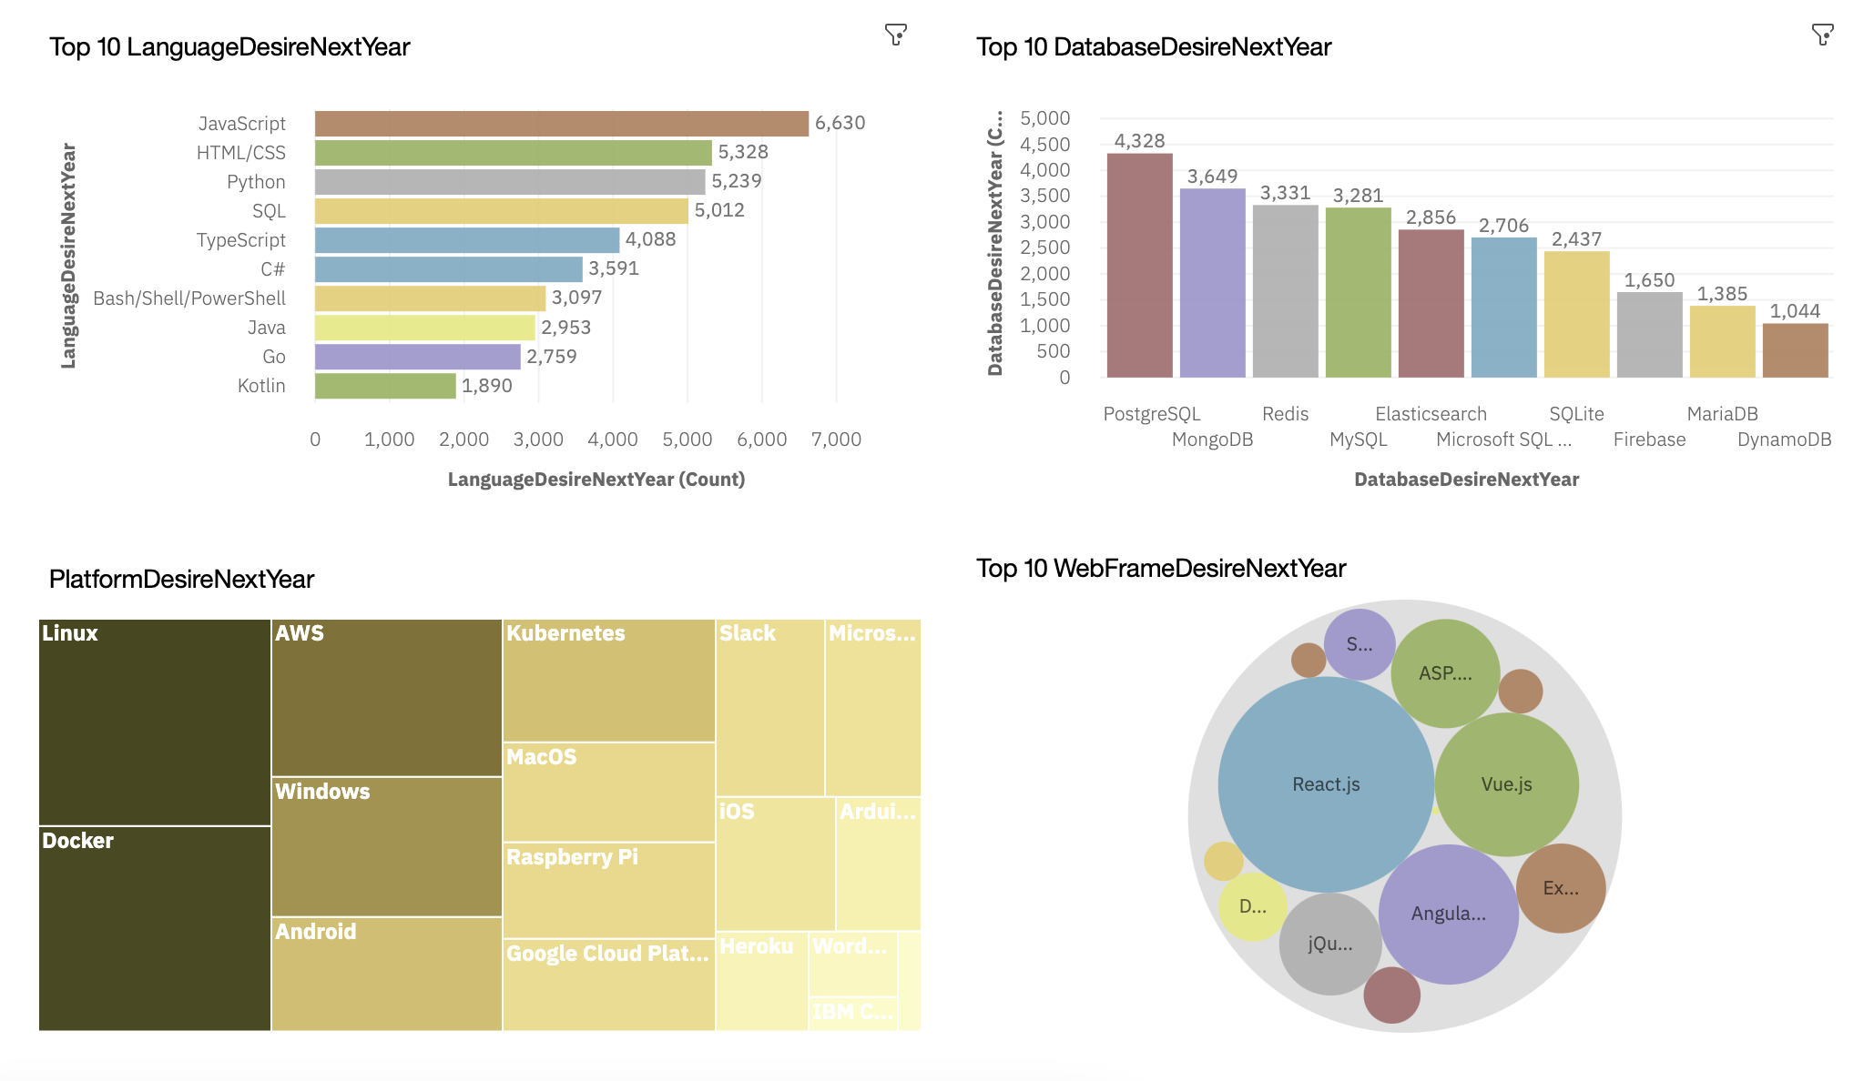
FUTURE USAGE

Slide 14
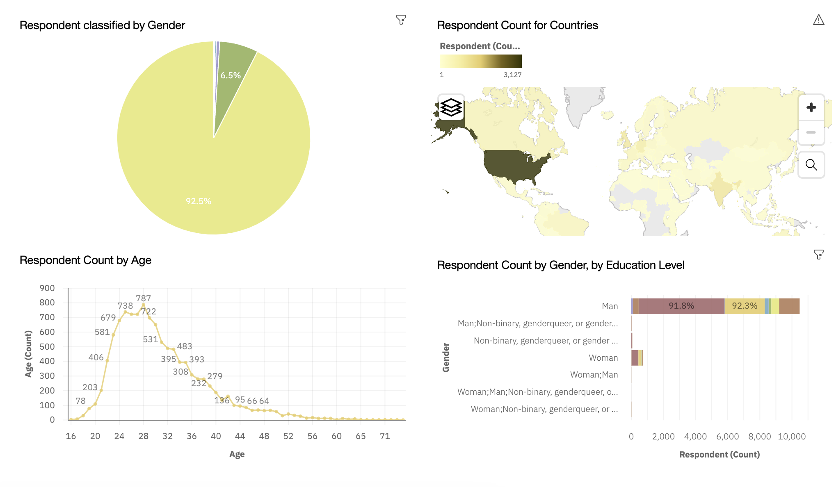
DEMOGRAPHICS

Slide 15
DISCUSSION

Slide 16
OVERALL FINDINGS & IMPLICATIONS
Findings
JavaScript losing market share but still on top
Male dominated field
Developers located in developed countries
Implications
Rapid changing technologies, companies need to be flexible
Developers localized to a few locations worldwide
Young developers with bachelors degree the majority

Slide 17

CONCLUSION
Current and Future Technology Trends
Programming Languages, Databases, and Platform data
Location, gender, and education demographics
Future changed due to AI

Slide 18

APPENDIX

Slide 19
JOB POSTINGS

Slide 20
POPULAR LANGUAGES

